Slide 1
Principal Components Analysis (PCA)
Professorial fellow. G. Panda
IIT, Bhubaneswar, India
1/8/2019

Slide 2
Contents :
Dimensionality Reduction Motivations.
Principal Component Analysis (PCA).
Geometric Rationale of PCA
2D example.
Reconstruction of original Data.

Slide 3
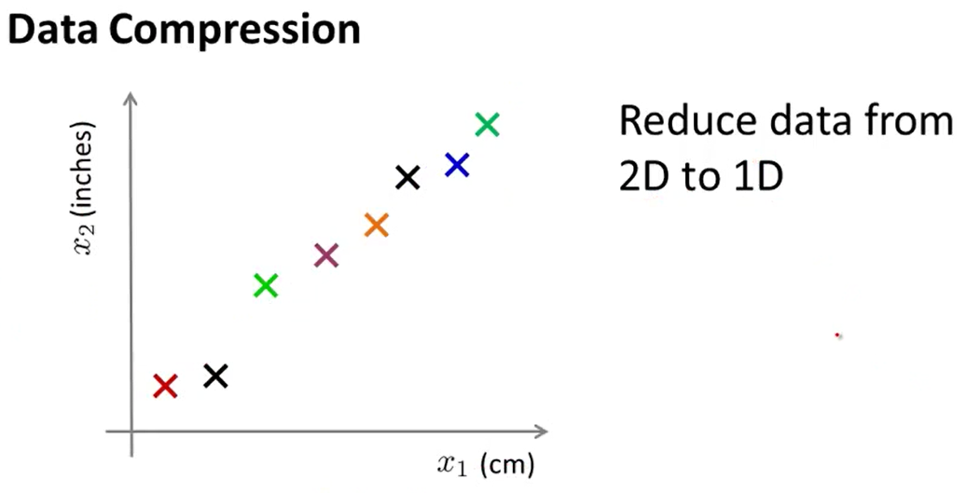
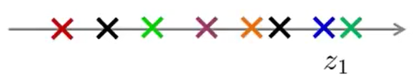


Dimensionality Reduction Motivations
$$z_{1}$$
Goal is to find line ($z_{1}$) and project all data on that line. Then (x,y) coordinates will be just ($z_{1}$) coordinate after that projection.

Slide 4
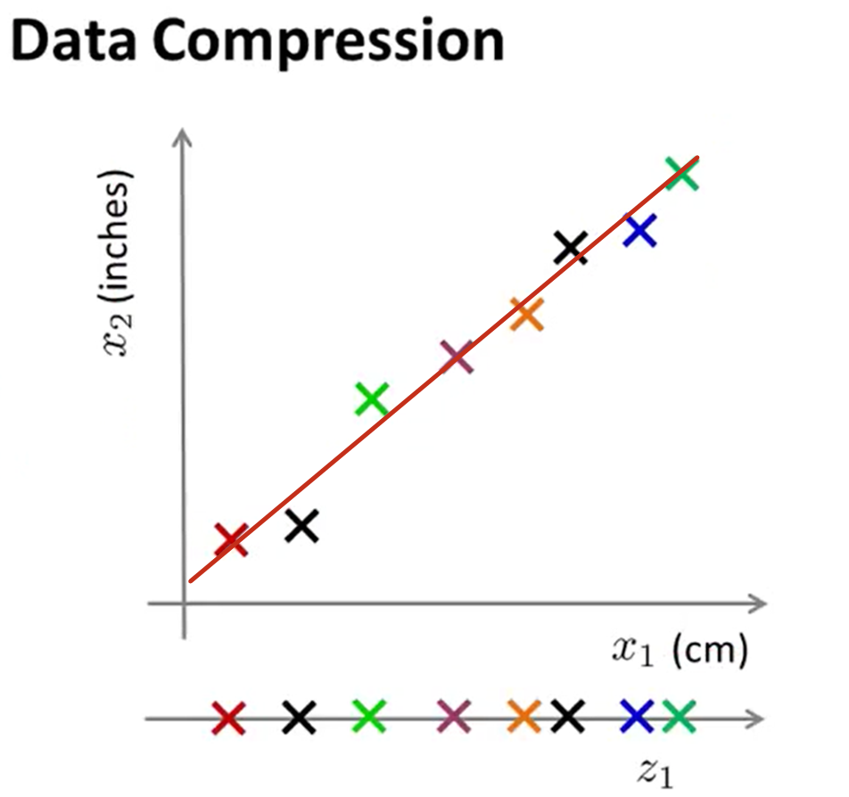
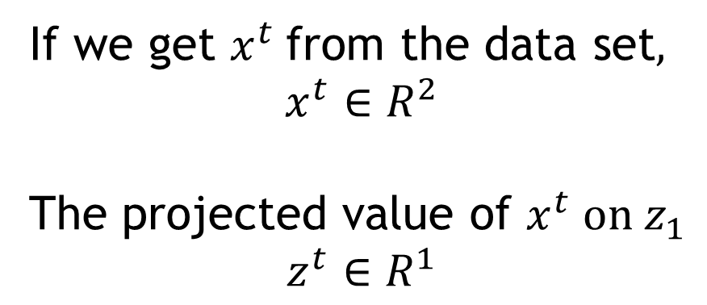


Dimensionality Reduction Motivations (Cont.)
If we get $x^{t}$from the data set$,$
$$x^{t}∈R^{2}$$
The projected value of $x^{t} on{ z}_{1}$
$$z^{t}∈R^{1}$$
$$x^{t}$$
$$z^{t}$$

Slide 5
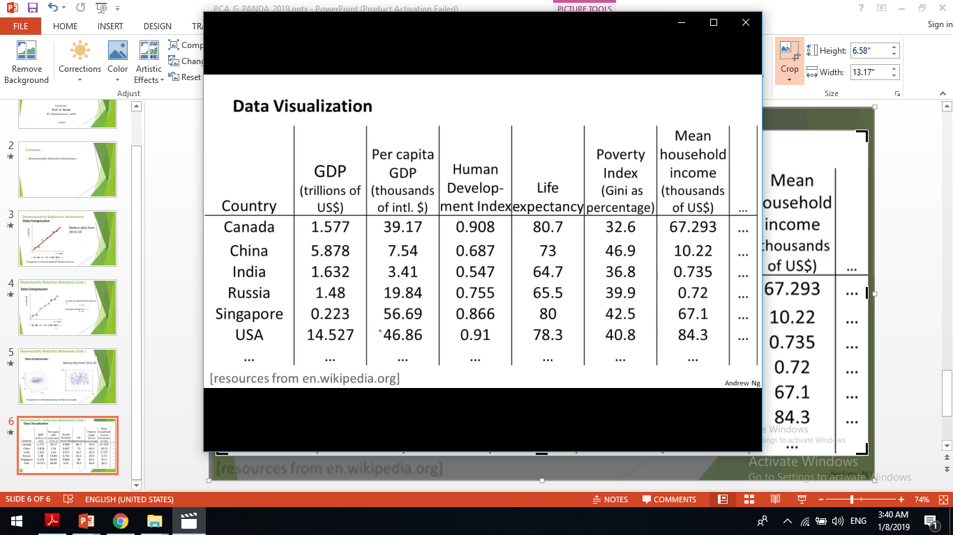
Dimensionality Reduction Motivations (Cont.)
Many features
Notes:
Gross Domestic Product

Slide 6
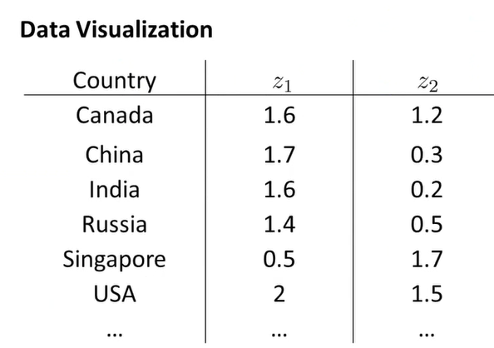
Dimensionality Reduction Motivations (Cont.)
Country size GDP
Per person GDP

Slide 7
Dimensionality Reduction Motivations (Cont.)
Example: 53 Blood and urine measurements (wet chemistry) from 65 people (33 alcoholics, 32 non-alcoholics).
Matrix Format
Spectral Format

Slide 8
Dimensionality Reduction Motivations (Cont.)
Univariate
Bivariate
Trivariate

Slide 9
Dimensionality Reduction Motivations (Cont.)
Better presentation than ordinate axes?
Do we need a 53 dimension space to view data?
How to find the ‘best’ low dimension space that conveys maximum useful information?
One answer: Find “Principal Components”

Slide 10
Principal Components Analysis (PCA)
Take a data matrix of n objects by p variables, which may be correlated, and summarizes it by uncorrelated axes (principal components or principal axes) that are linear combinations of the original p variables.
Display the first k components as much as possible of the variation among objects.

Slide 11
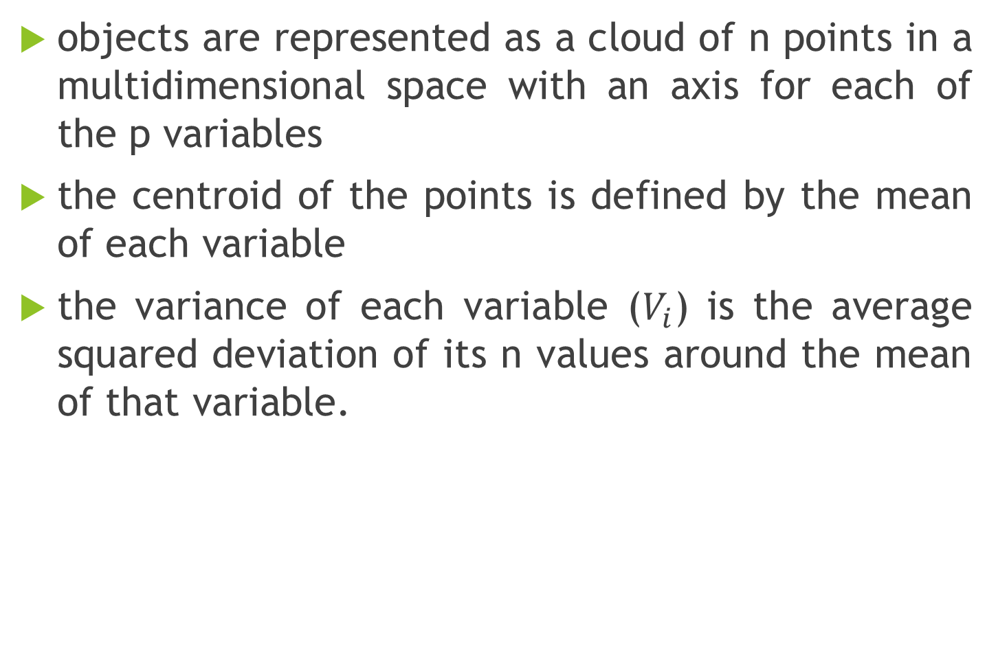
Geometric Rationale of PCA
objects are represented as a cloud of n points in a multidimensional space with an axis for each of the p variables
the centroid of the points is defined by the mean of each variable
the variance of each variable ($V_{i}$) is the average squared deviation of its n values around the mean of that variable.

Slide 12
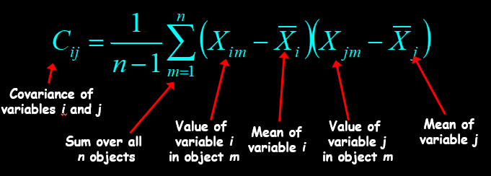
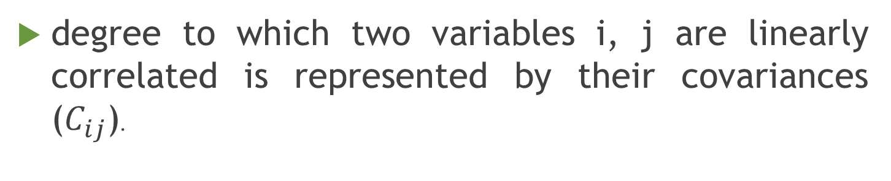
Geometric Rationale of PCA
degree to which two variables i, j are linearly correlated is represented by their covariances ($C_{ij}$).

Slide 13
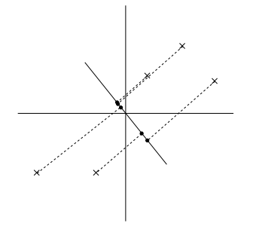
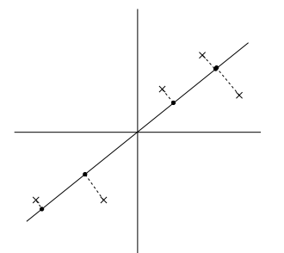
Geometric Rationale of PCA (Cont.)
The projected data still has a fairly large variance, and the points tend to be far from zero. In contrast, suppose had instead picked the following direction:
Little variance between projected
data
Large variance between projected
data

Slide 14
Geometric Rationale of PCA
objective of PCA is to rigidly rotate the axes of this p-dimensional space to new positions (principal axes). Those new positions have the following properties:
Ordered principal axes : such that principal axis 1 has the highest variance, axis 2 has the next highest variance, .... , and axis p has the lowest variance
Uncorrelated principal axes : covariance among each pair of the principal axes is zero.

Slide 15
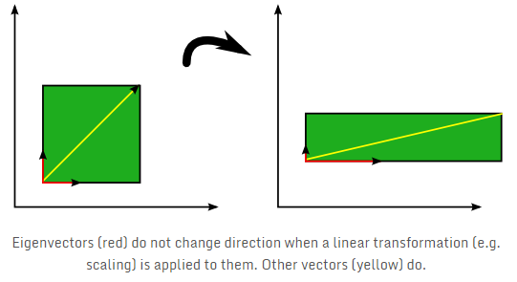
Geometric Rationale of PCA (Cont.)

Slide 16
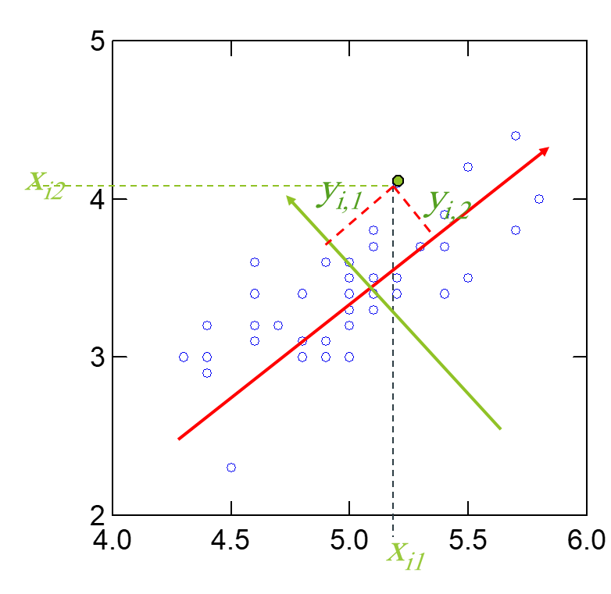
PCA for 2D
2nd Principal
Component, y₂
1st Principal
Component, y₁

Slide 17

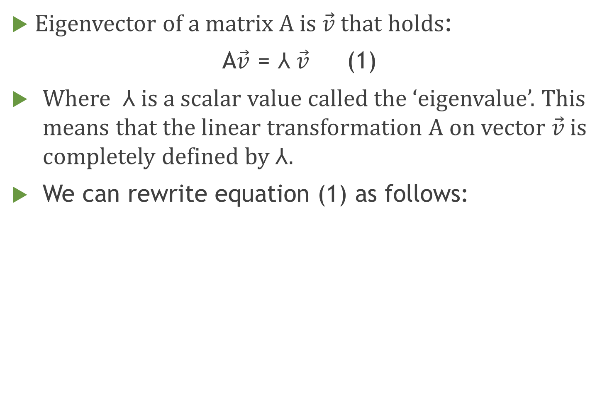
PCA eigenvectors
Eigenvector of a matrix A is $\vec{v}$ that holds:
A$\vec{v}$ = ⅄ $\vec{v}$ (1)
Where ⅄ is a scalar value called the ‘eigenvalue’. This means that the linear transformation A on vector $\vec{v}$ is completely defined by ⅄.
We can rewrite equation (1) as follows:

Slide 18
PCA eigenvectors (Cont.)
where I is the identity matrix of the same dimensions as A .
In order to find the eigenvectors of A , we simply have to solve the following equation:

Slide 19
PCA Example
Subtract the mean
from each of the data dimensions. All the x values have x subtracted and y values have y subtracted from them. This produces a data set whose mean is zero.
Subtracting the mean makes variance and covariance calculation easier by simplifying their equations. The variance and co-variance values are not affected by the mean value.

Slide 20
PCA Example –STEP 1

Slide 21
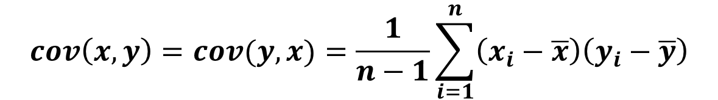
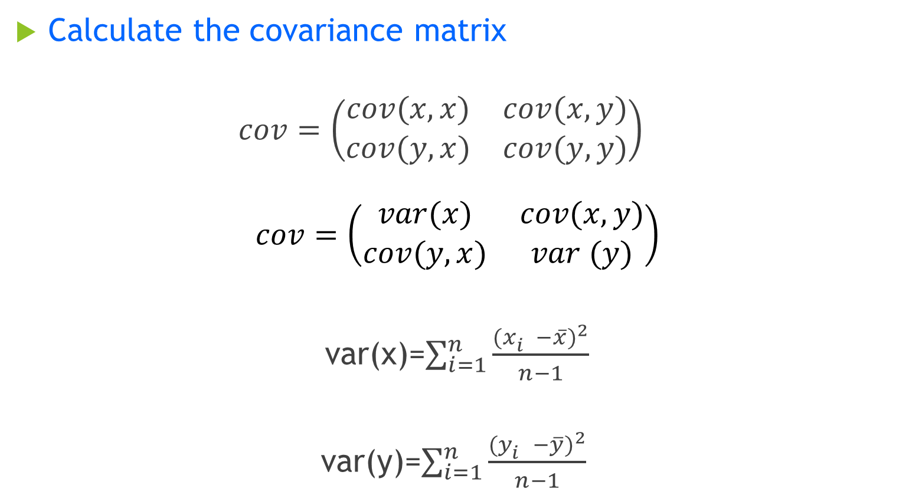
PCA Example –STEP 2
Calculate the covariance matrix
$$cov=\left(\begin{matrix}cov(x,x) & cov(x,y) \\ cov(y,x) & cov(y,y)\end{matrix}\right)$$
$$cov=\left(\begin{matrix}var(x) & cov(x,y) \\ cov(y,x) & var (y)\end{matrix}\right)$$
var(x)=$\sum_{i=1}^{n}{\frac{{(x_{i}^{}−\overline{x})}^{2}}{n−1}}$
var(y)=$\sum_{i=1}^{n}{\frac{{(y_{i}^{}−\overline{y})}^{2}}{n−1} }$
$$cov\left(x,y\right)=cov(y,x)=\frac{1}{n−1}\sum_{i=1}^{n}{\left(x_{i}−\overline{x}\right)\left(y_{i}−\overline{y}\right)}$$

Slide 22
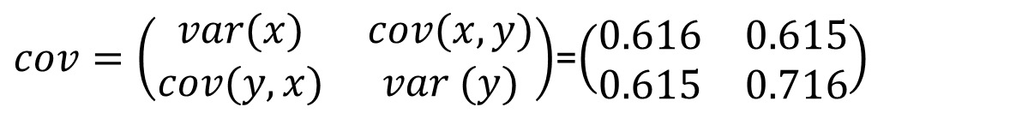
PCA Example –STEP 2 (Cont.)
$cov=\left(\begin{matrix}var(x) & cov(x,y) \\ cov(y,x) & var (y)\end{matrix}\right)$=$\left(\begin{matrix}0.616 & 0.615 \\ 0.615 & 0.716\end{matrix}\right)$

Slide 23

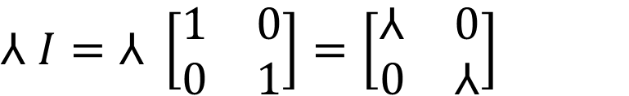

PCA Example –STEP 3: Calculating eignevalues
The eigenvalues λi are found by solving the equation
det(cov-λI)=0
$⅄ I=⅄ \left[\begin{matrix}1 & 0 \\ 0 & 1\end{matrix}\right]=\left[\begin{matrix}⅄ & 0 \\ 0 & ⅄\end{matrix}\right]$
cov$−⅄ I=\left[\begin{matrix}0.616−⅄ & 0.615 \\ 0.615 & 0.716−⅄\end{matrix}\right]$
det (cov- $⅄I)=(0.616−⅄$)(0.716 - $⅄$)-(0.615*0.615)
det (cov- $⅄I)=0.063−1.332⅄$ +$⅄^{2}$

Slide 24
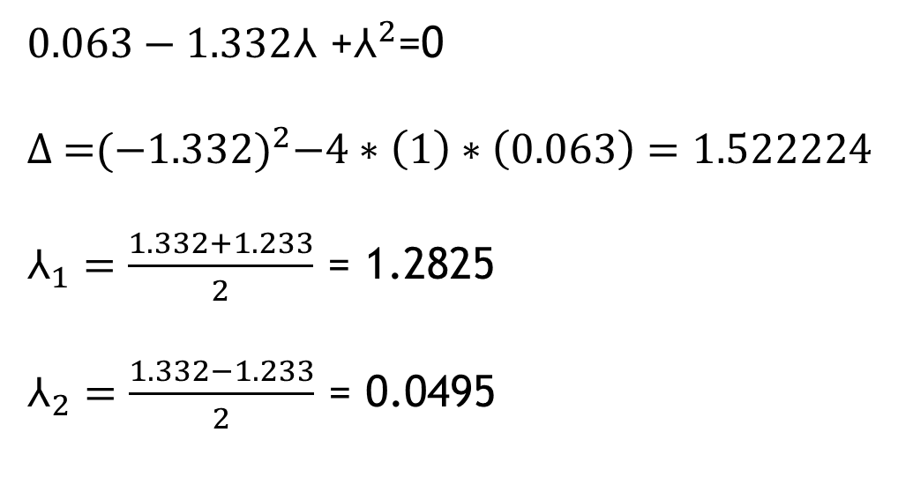


PCA Example –STEP 3: Calculating eignevalues (Cont.)
det (cov- $⅄I)=0.063−1.332⅄$ +$⅄^{2}$
Sloving det (cov-⅄I)=0 gives eigen Values.
$0.063−1.332⅄$ +$⅄^{2}$=0
Δ =${(−1.332)}^{2}−4∗\left(1\right)∗\left(0.063\right)=1.522224$
$⅄_{1}=\frac{1.332+1.233}{2}$ = 1.2825
$⅄_{2}=\frac{1.332−1.233}{2}$ = 0.0495
$$eigenvalues are \left(\begin{matrix}1.2825 \\ 0.0495\end{matrix}\right)$$

Slide 25
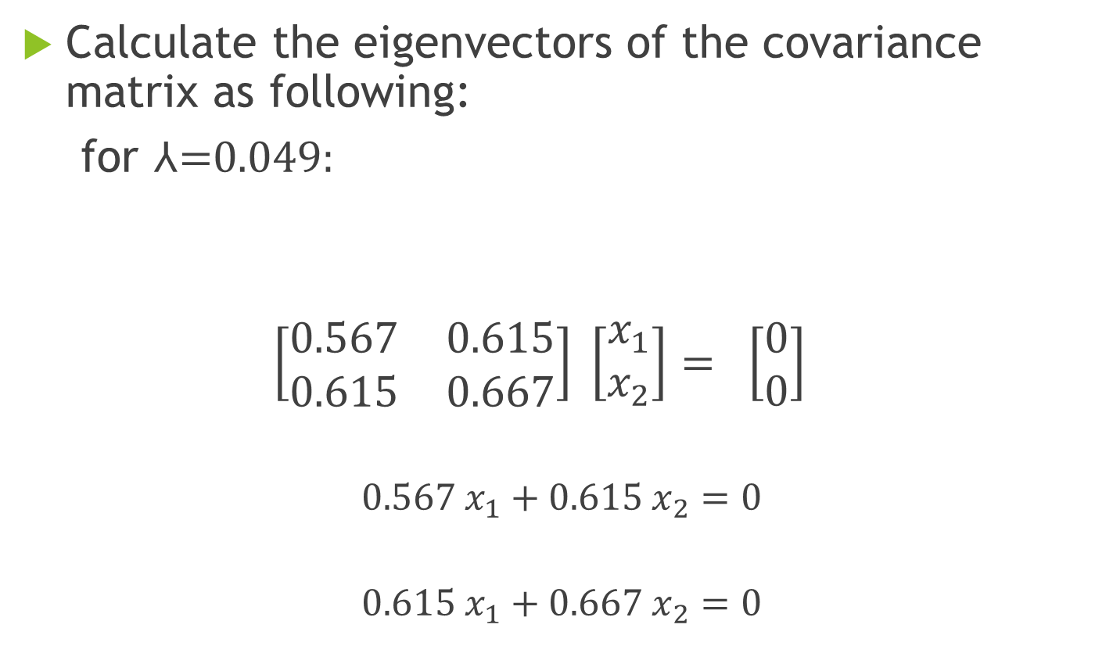
PCA Example –STEP 4: Calculating eigenvectors
Calculate the eigenvectors of the covariance matrix as following:
for ⅄=0.049:
$$\left[\begin{matrix}0.567 & 0.615 \\ 0.615 & 0.667\end{matrix}\right] \left[\begin{matrix}x_{1} \\ x_{2}\end{matrix}\right]= \left[\begin{matrix}0 \\ 0\end{matrix}\right]$$
$$0.567 x_{1}+0.615 x_{2}=0$$
$$0.615 x_{1}+0.667 x_{2}=0$$
$C−⅄ I=\left[\begin{matrix}0.616−⅄ & 0.615 \\ 0.615 & 0.716−⅄\end{matrix}\right]= \left[\begin{matrix}0.567 & 0.615 \\ 0.615 & 0.667\end{matrix}\right]$

Slide 26
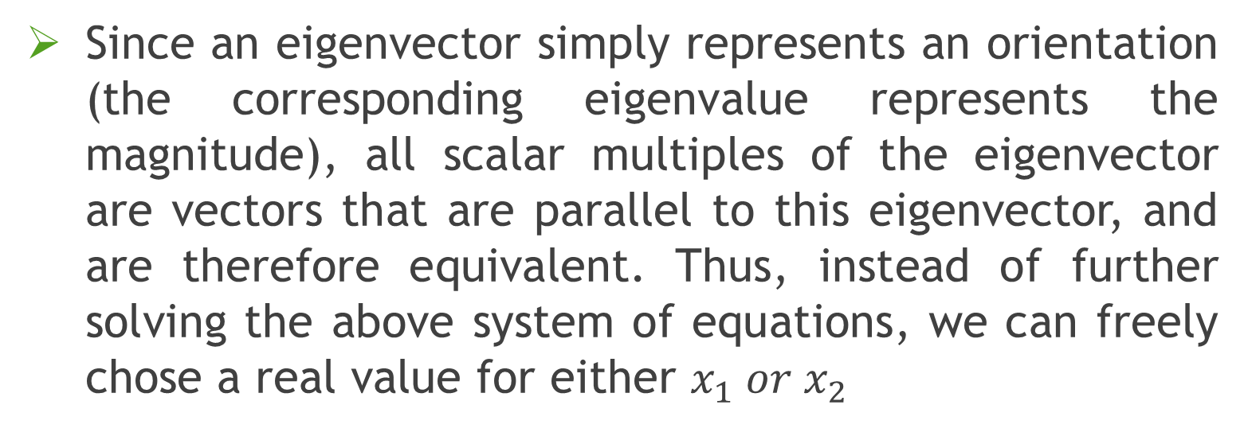
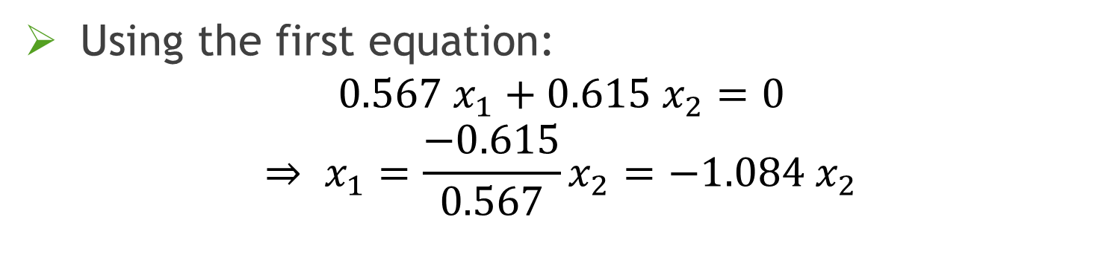
PCA Example –STEP 4: Calculating eigenvectors (Cont.)
Using the first equation:
$$0.567 x_{1}+0.615 x_{2}=0$$
$$⇒ x_{1}=\frac{−0.615}{0.567}x_{2}=−1.084 x_{2}$$
Since an eigenvector simply represents an orientation (the corresponding eigenvalue represents the magnitude), all scalar multiples of the eigenvector are vectors that are parallel to this eigenvector, and are therefore equivalent. Thus, instead of further solving the above system of equations, we can freely chose a real value for either $x_{1} or x_{2}$

Slide 27
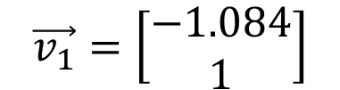

PCA Example –STEP 4: Calculating eigenvectors (Cont.)
Suppose $x_{2}=1 ⟹ x_{1}=−1.084$
Therefore, the eigenvector that corresponds to eigenvalue ⅄=0.049 is:
$$\vec{v_{1}}=\left[\begin{matrix}−1.084 \\ 1\end{matrix}\right]$$

Slide 28
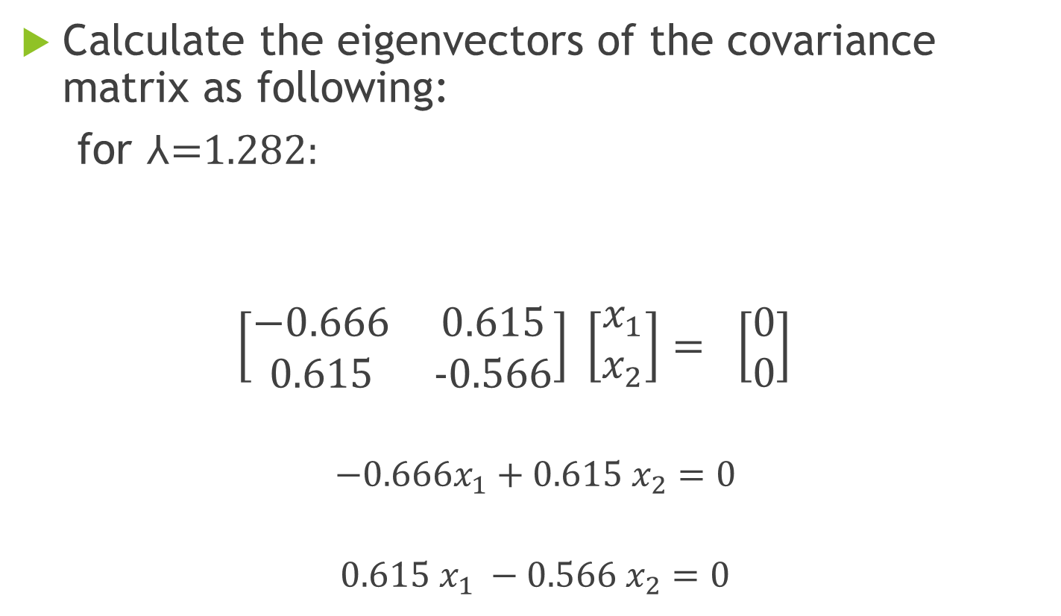
PCA Example –STEP 4: Calculating eigenvectors (Cont.)
Calculate the eigenvectors of the covariance matrix as following:
for ⅄=1.282:
$$\left[\begin{matrix}−0.666 & 0.615 \\ 0.615 & −0.566\end{matrix}\right] \left[\begin{matrix}x_{1} \\ x_{2}\end{matrix}\right]= \left[\begin{matrix}0 \\ 0\end{matrix}\right]$$
$$−0.666x_{1}+0.615 x_{2}=0$$
$$0.615 x_{1} −0.566 x_{2}=0$$
$C−⅄ I=\left[\begin{matrix}0.616−⅄ & 0.615 \\ 0.615 & 0.716−⅄\end{matrix}\right]= \left[\begin{matrix}−0.666 & 0.615 \\ 0.615 & −0.566\end{matrix}\right]$

Slide 29


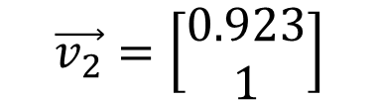
PCA Example –STEP 4: Calculating eigenvectors (Cont.)
Using the first equation:
$$−0.666x_{1}+0.615 x_{2}=0$$
$$⇒ x_{1}=\frac{−0.615}{−0.666}x_{2}=0.923 x_{2}$$
Suppose $x_{2}=1 ⟹ x_{1}=0.923$
Therefore, the eigenvector that corresponds to eigenvalue ⅄=1.282 is:
$$\vec{v_{2}}=\left[\begin{matrix}0.923 \\ 1\end{matrix}\right]$$

Slide 30
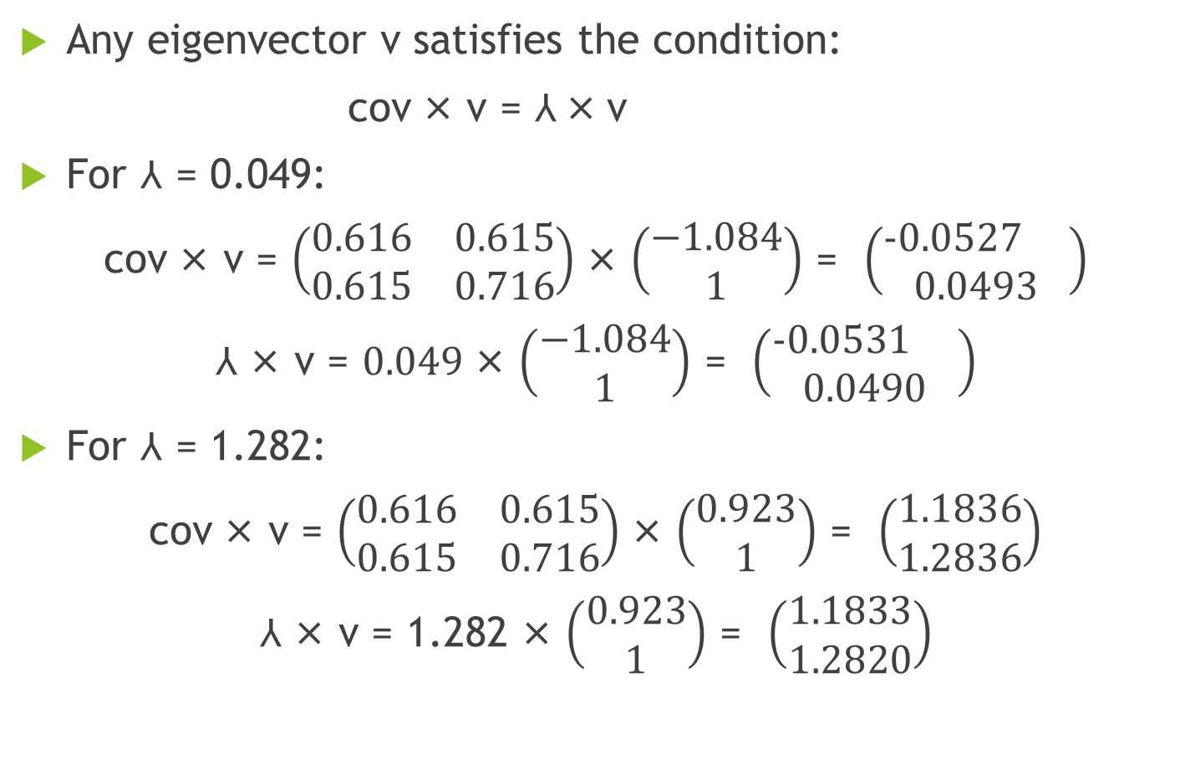
PCA Example –STEP 4: Calculating eigenvectors (Cont.)
Any eigenvector v satisfies the condition:
cov × v = ⅄ × v
For ⅄ = 0.049:
cov × v = $\left(\begin{matrix}0.616 & 0.615 \\ 0.615 & 0.716\end{matrix}\right)$ × $\left(\begin{matrix}−1.084 \\ 1\end{matrix}\right)$ = $\left(\begin{matrix}−0.0527 \\ 0.0493\end{matrix}\right)$
⅄ × v = $0.049$ × $\left(\begin{matrix}−1.084 \\ 1\end{matrix}\right)$ = $\left(\begin{matrix}−0.0531 \\ 0.0490\end{matrix}\right)$
For ⅄ = 1.282:
cov × v = $\left(\begin{matrix}0.616 & 0.615 \\ 0.615 & 0.716\end{matrix}\right)$ × $\left(\begin{matrix}0.923 \\ 1\end{matrix}\right)$ = $\left(\begin{matrix}1.1836 \\ 1.2836\end{matrix}\right)$
⅄ × v = 1.282 × $\left(\begin{matrix}0.923 \\ 1\end{matrix}\right)$ = $\left(\begin{matrix}1.1833 \\ 1.2820\end{matrix}\right)$

Slide 31
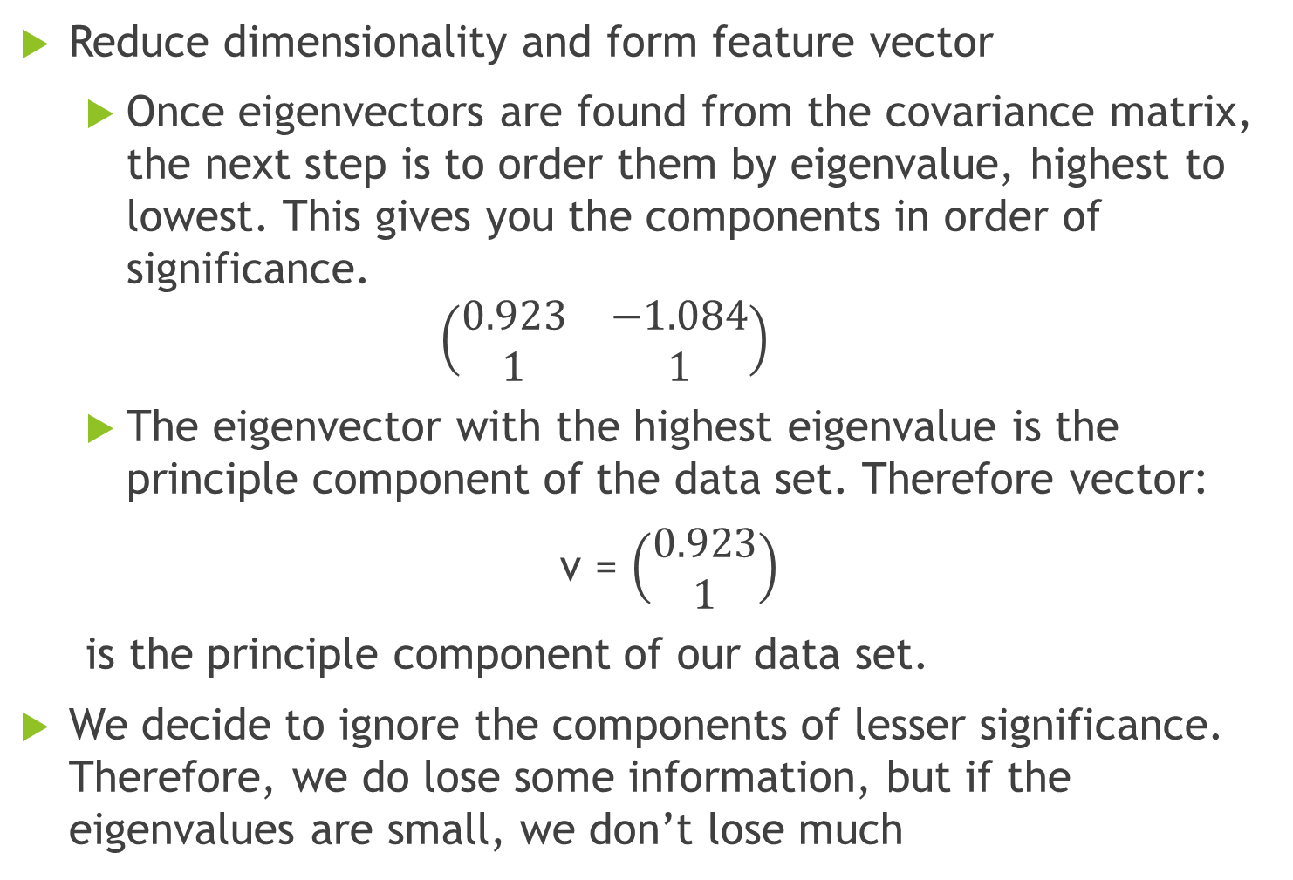
PCA Example –STEP 5
Reduce dimensionality and form feature vector
Once eigenvectors are found from the covariance matrix, the next step is to order them by eigenvalue, highest to lowest. This gives you the components in order of significance.
$$\left(\begin{matrix}0.923 & −1.084 \\ 1 & 1\end{matrix}\right)$$
The eigenvector with the highest eigenvalue is the principle component of the data set. Therefore vector:
v = $\left(\begin{matrix}0.923 \\ 1\end{matrix}\right)$
is the principle component of our data set.
We decide to ignore the components of lesser significance. Therefore, we do lose some information, but if the eigenvalues are small, we don’t lose much

Slide 32
PCA Example –STEP 5 (Cont.)
Feature vector of our dataset is f=(x,y), of size 10*2 in or example.
Principle component of our dataset is v, of size 2*1.
To reduce feature vector dimension, we multiply zero mean feature vector with principle component: f*v . The resulted dataset will be of size 10*1.

Slide 33
PCA Example –STEP 5 (Cont.)
Reduced Data set
x
1.1269 -2.4191 1.3500 0.3731 2.2807 1.2423 -0.1346 -1.5576 -0.5961 -1.6653

Slide 34
Thank You

